Slide 1
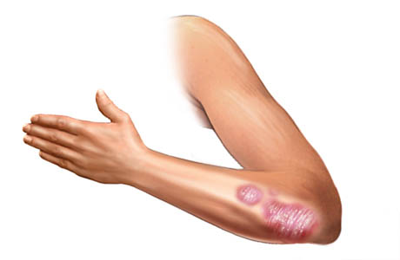
A Computational Biology Framework
Creating a platform for Biomedical Engineers to improve their data mining efficiency

Slide 2
Contents
Case Study
Introduction
Analysis
Feature Reduction
Clustering
Psoriasis vs Atopic Dermatitis
Framework Conclusion
Framework Proposal
Layout
5 aspects
General information
Planning
Reports
A Computational Biology Framework

Slide 3
Case Study
Basic Analysis Skin Disease Data Set

Slide 4
Introduction
Introduction
Data sets
6 psoriasis
3 atopic dermatitis
Values
54675 genes
Normal, Non-Lesional, Lesional
Focus
Biggest set: Psoriasis
Normal vs Non-Lesional?
Non-Lesional vs Lesional (423)
Additional data
Gene specific details
Process, Cellular, Molecular information
A Computational Biology Framework

Slide 5
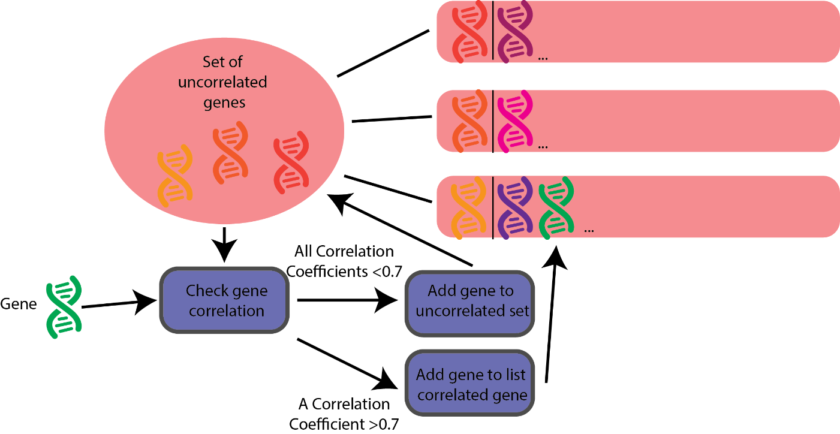
Methods (1)
Feature Reduction
T-test
Separate datasets
Joint dataset
Greedy Correlation Clustering
Machine Learning
Decision Tree
Random Forest
A Computational Biology Framework

Slide 6
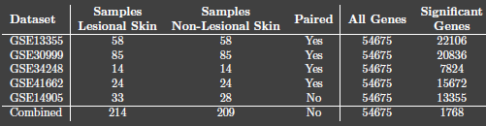

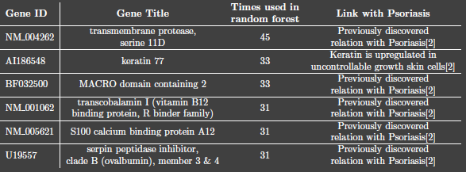
Results (1)
Feature Reduction
T-test
P-value = 0.001
54675 -> 1768 genes
Greedy Correlation Clustering
1768 genes -> 335 genes
Machine Learning
Decision tree
Random forests
A Computational Biology Framework

Slide 7
Methods (2)
Clustering
Normalization
Per feature/sample
Clustering by biomedical relation
Process
Cellular Location
Molecular reaction
Clustering by value
K-means
Agglomerative
DBSCAN
Combined clustering
Most interesting genes
A Computational Biology Framework

Slide 8
Results (2)
Clustering
Biomedical Relation Clustering
Processes were most interesting
No useful results
A Computational Biology Framework

Slide 9
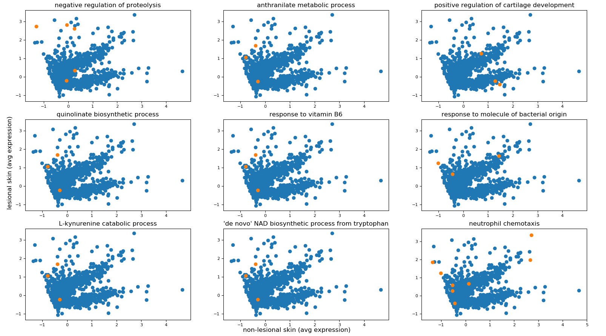
Results (2)
Clustering
Biomedical Relation Clustering
A Computational Biology Framework

Slide 10
Results (2)
Clustering
Clustering by biomedical relation
Processes were most interesting
No useful results
Clustering by values
On its own, no interesting results
Combining clustering types
Agglomerative Clustering, 10 clusters
2 interesting clusters
Labeled genes in clusters
A Computational Biology Framework

Slide 11
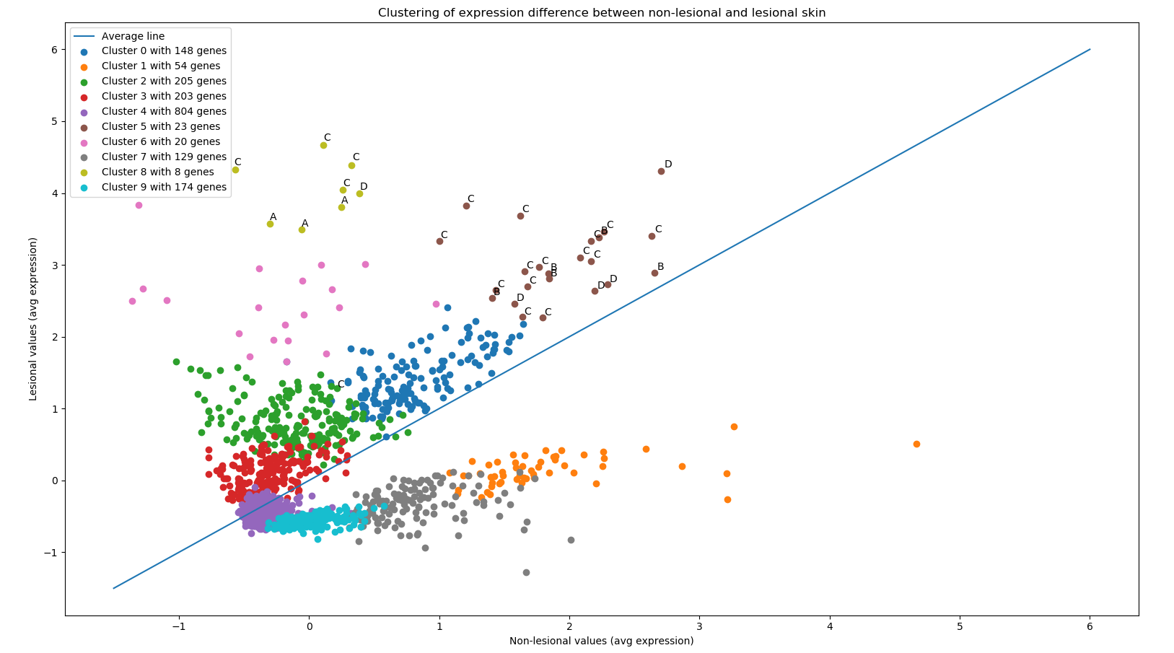
Results (2)
Clustering
Clustering by biomedical relation
Processes were most interesting
No useful results
Clustering by values
On its own, no interesting results
Combining clustering types
Agglomerative Clustering, 10 clusters
2 interesting clusters
Labeled genes in clusters
A Computational Biology Framework

Slide 12

Methods & Results (3)
Psoriasis versus Atopic Dermatitis
Matched genes
96 genes significant in both
Linked genes to biomedical relations
No remarkable results
5 prominent processes
Metabolic process
Small molecule metabolic process
Regulation of transcription, DNA-templated
Signal transduction
Transcription, DNA templated
Fundamental processes
A Computational Biology Framework

Slide 13
Framework
conclusions
Framework conclusions
Global analysis
Features
Samples
Feature dimensionality
Multicollinearity
Other options
Database integration
Biomedical information
A Computational Biology Framework

Slide 14
Framework Proposal
Current view of the framework

Slide 15
Framework
Layout
Introduction
Five parts
Data driven
Target driven
Tool availability driven
Extension driven
Knowledge driven
A Computational Biology Framework

Slide 16

Framework
Layout
A Computational Biology Framework

Slide 17
Framework
Layout
Data driven
Preprocessing
Feature reduction
Sample generation
Quality Enhancement
A Computational Biology Framework

Slide 18
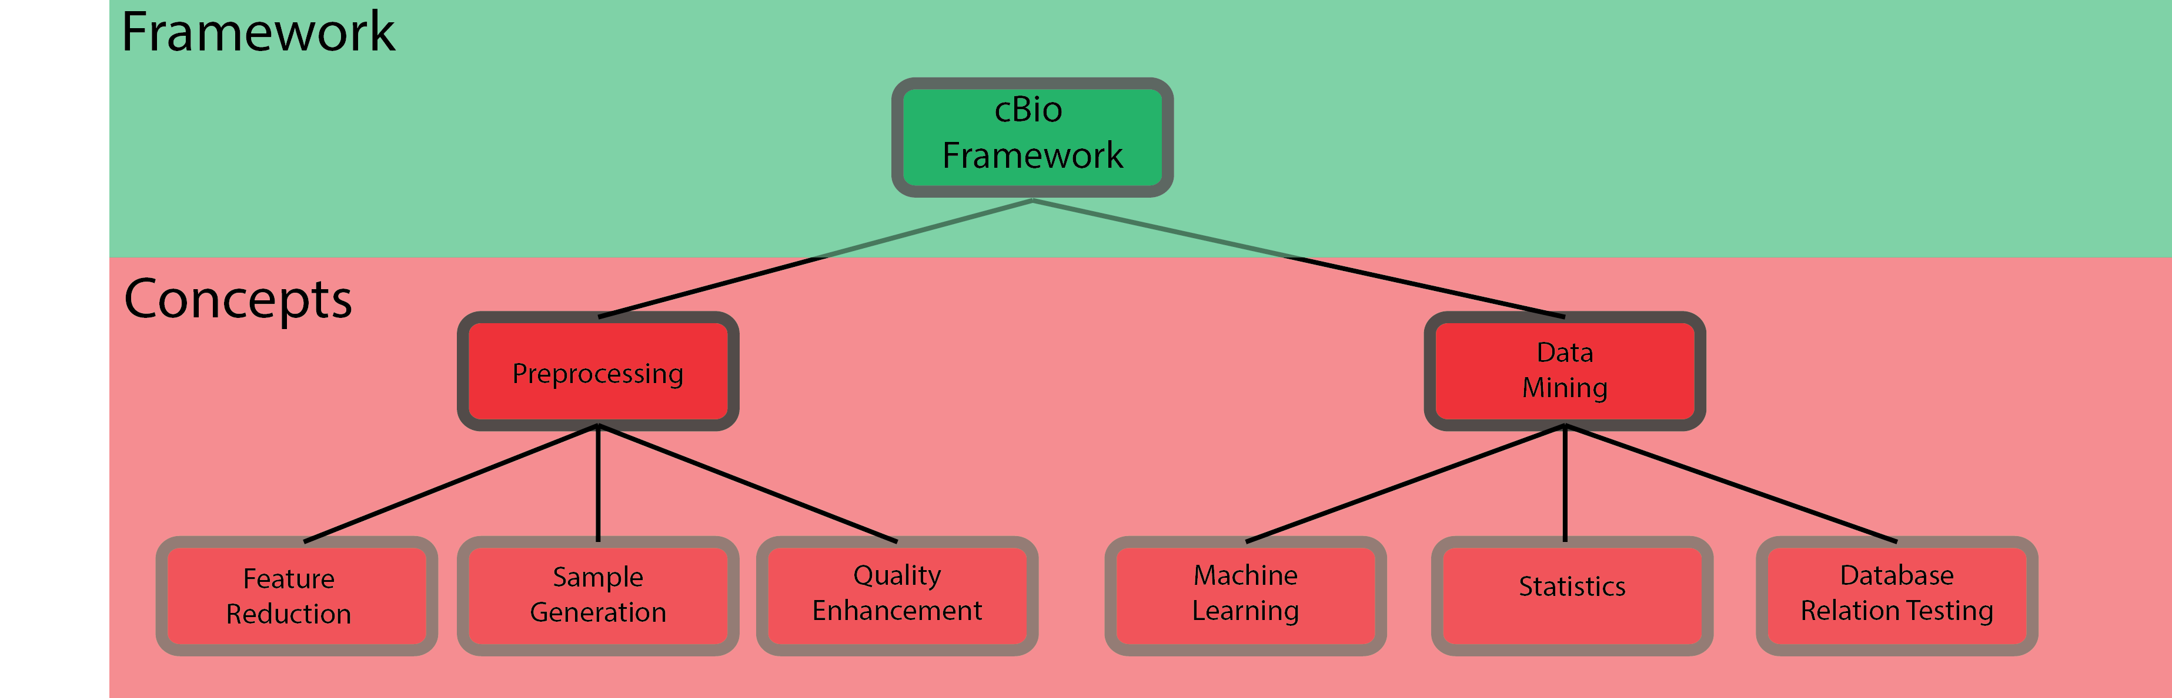
Framework
Layout
A Computational Biology Framework

Slide 19
Framework
Layout
Target driven
Data mining
Machine Learning
Statistics
Global Analysis
Database Relation Testing
A Computational Biology Framework

Slide 20
Framework
Layout
A Computational Biology Framework

Slide 21
Framework
Layout
Tool driven
Machine Learning
Scikit-learn
Statistics
SciPy
Combination
TPOT
A Computational Biology Framework

Slide 22
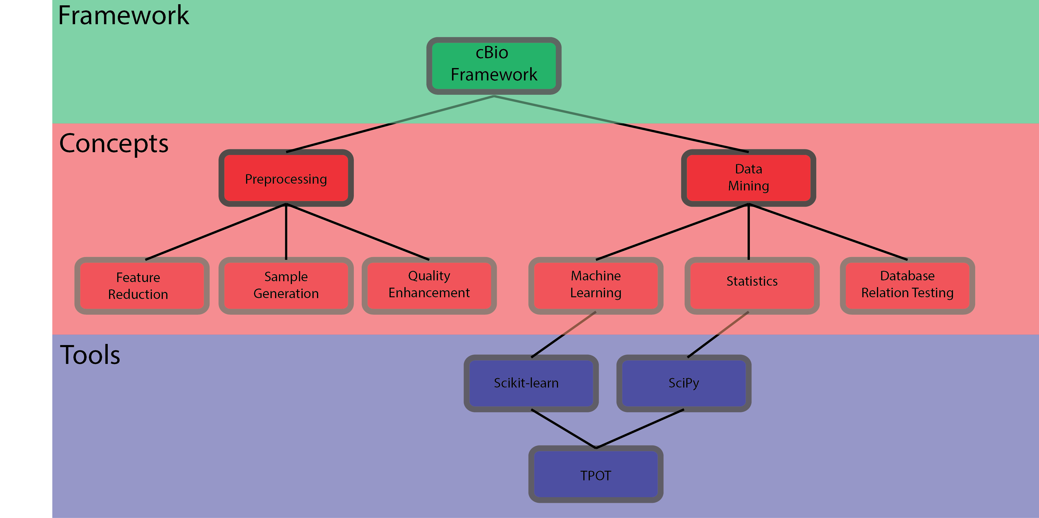
Framework
Layout
A Computational Biology Framework

Slide 23
Framework
Layout
Extension driven
Preprocessing
Preprocessing extension
Preprocessing addition to TPOT
Statistics
Global analysis tool
Database relation testing
Database integration
A Computational Biology Framework

Slide 24
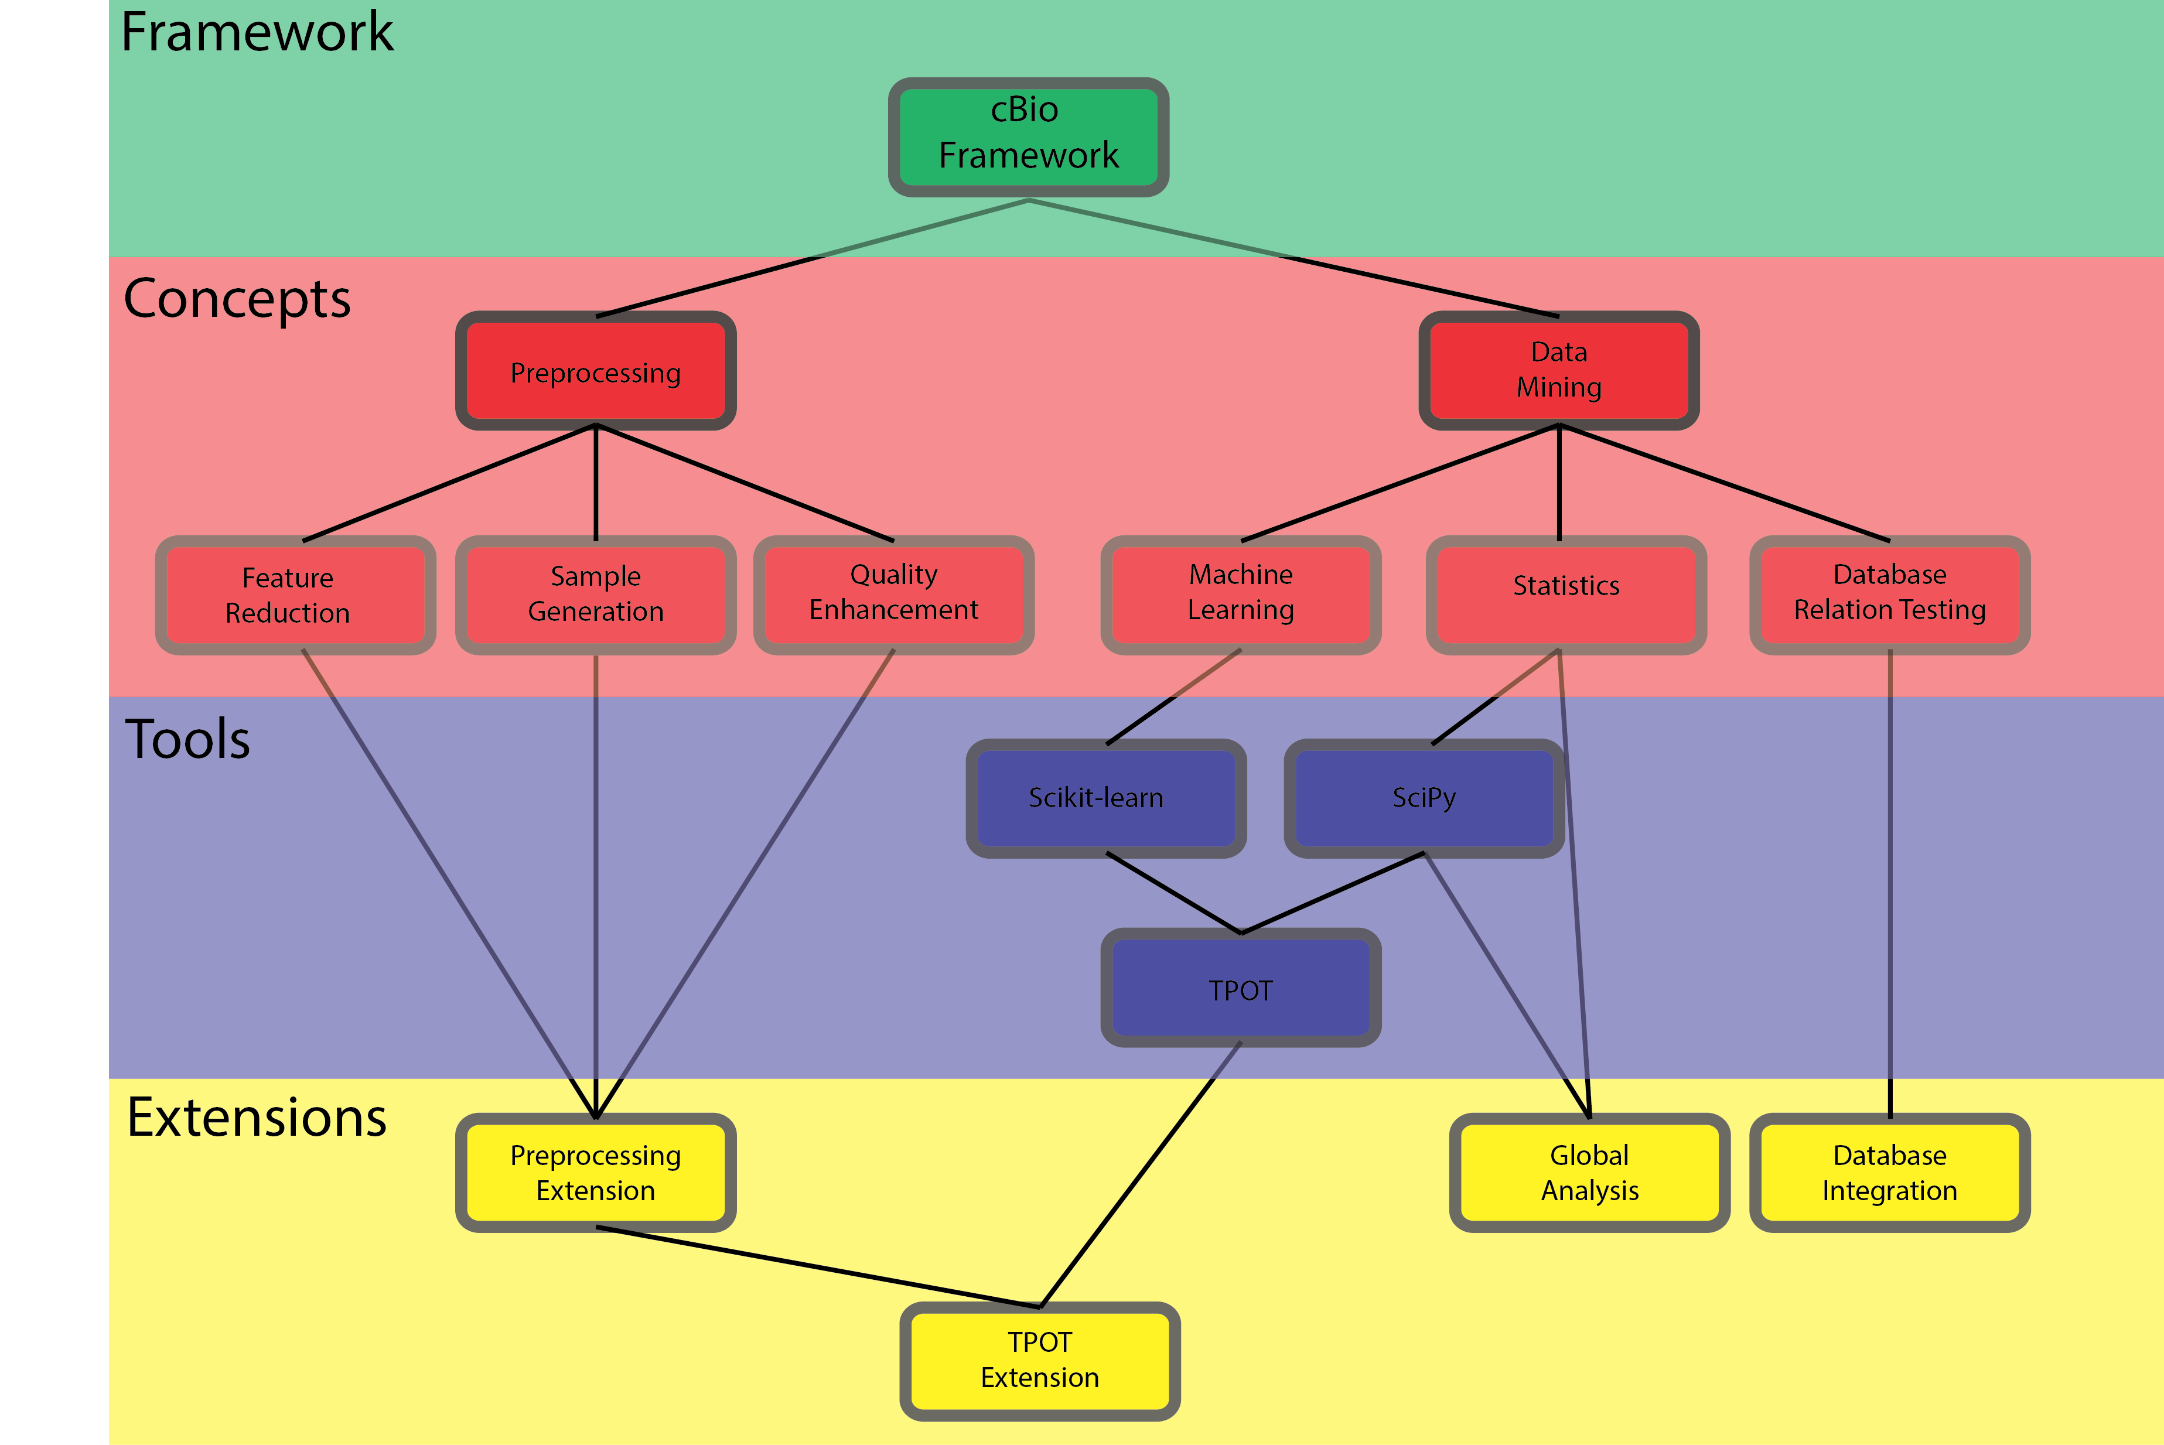
Framework
Layout
A Computational Biology Framework

Slide 25
Framework
Layout
Knowledge driven
Understandability
GUI
User Manual
Exemplary datasets
A Computational Biology Framework

Slide 26
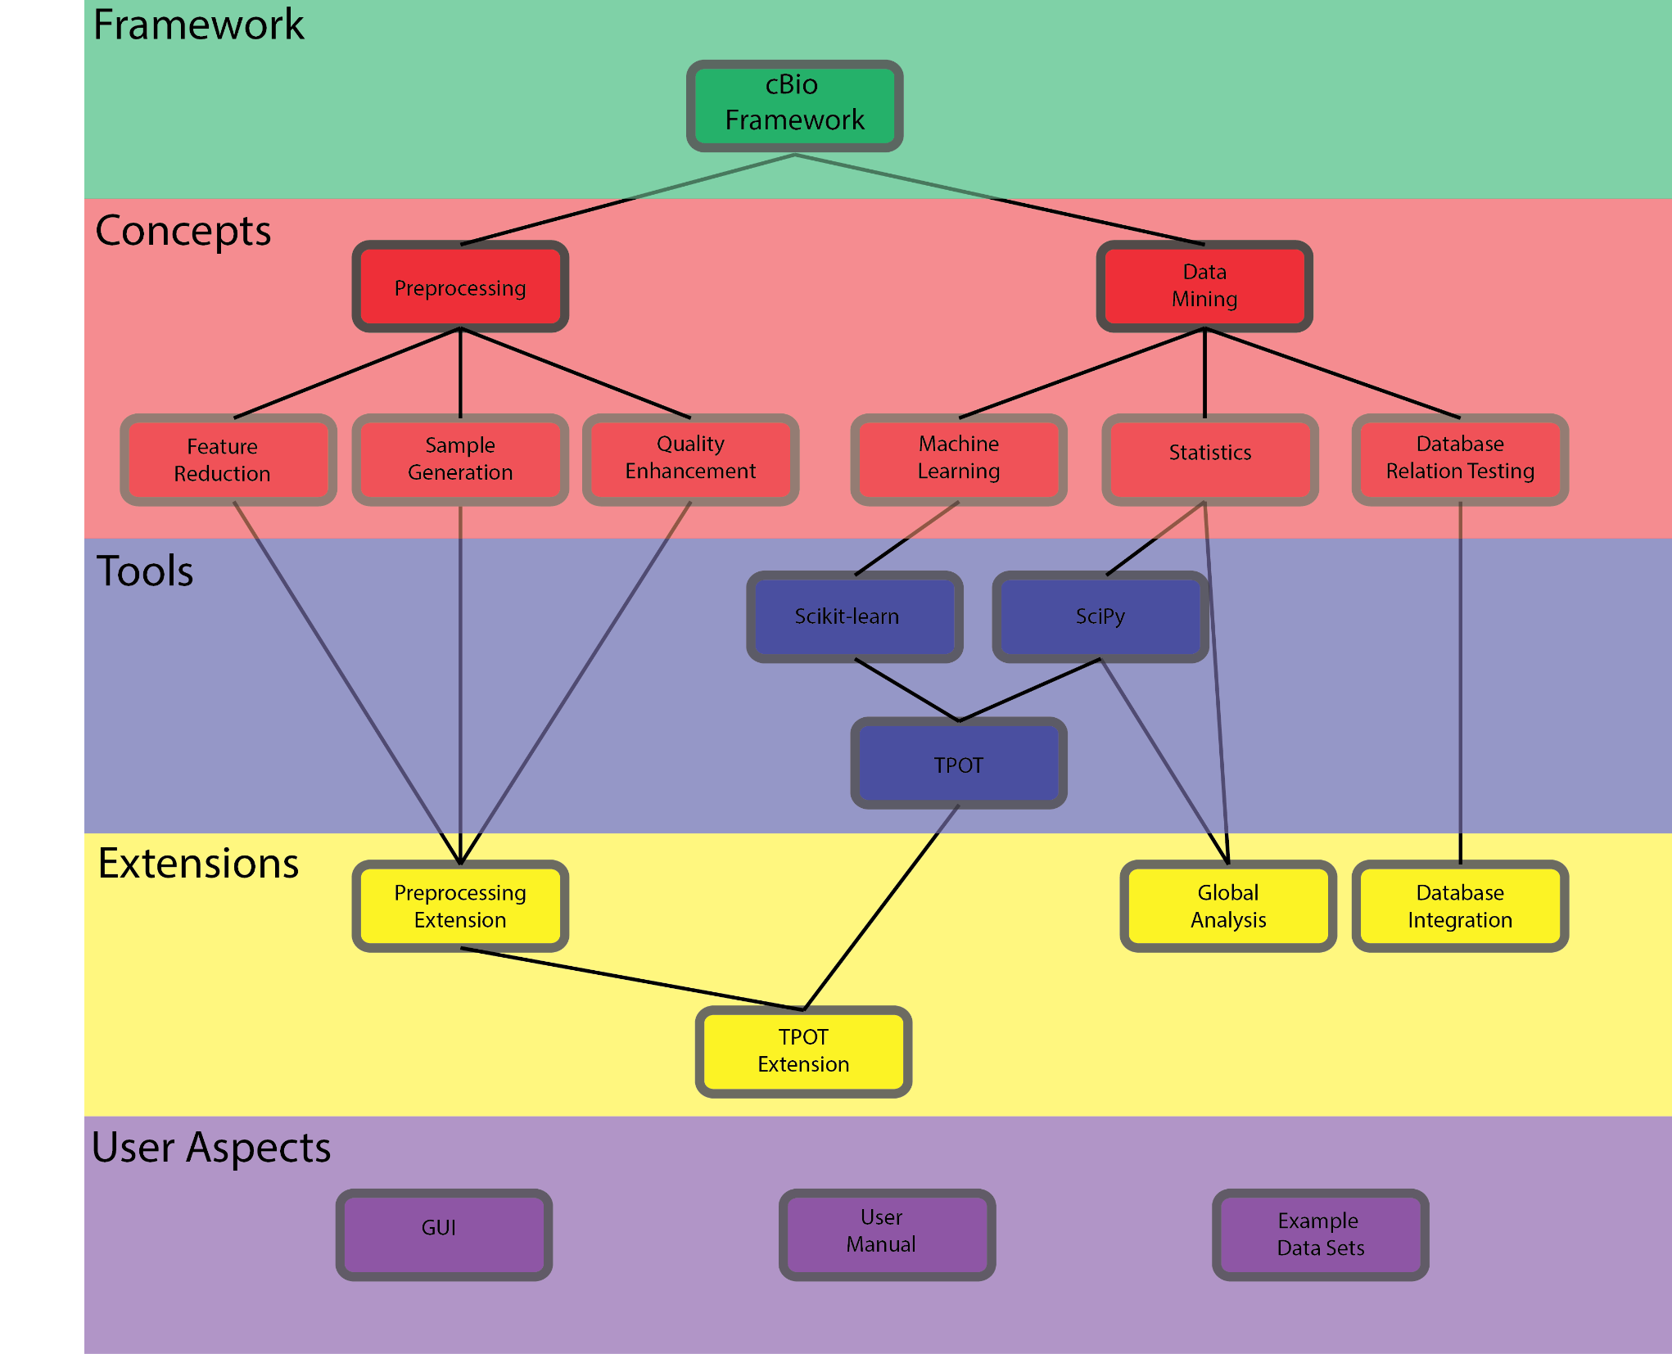
Framework
Layout
A Computational Biology Framework

Slide 27
General information
Which part of the program are made when?

Slide 28
Topic | Details | Timespan | Presentation date
Feature dimensionality reduction | Research additional options Use on data sets Implement as package Add to TPOT | 6 weeks | April 20th
Quality Enhancement | Research additional options Use on data sets Implement as package Add to TPOT | 6 weeks | June 1st
Sample Generation | Research additional options Use on data sets Implement as package Add to TPOT | 6 weeks | July 13th
Framework usability | Create GUI Create User Manual Create Global Analysis Add usability TPOT Possible: Add database integration | 8 weeks | To be determined
Project planning
A Computational Biology Framework

Slide 29
General questions
Case Study and Proposal Report
General remarks
Thesis layout
Merging four reports
Past/present tense
A Computational Biology Framework

